Slide 1
Chapter 23 & 24
DC Circuits
Electric Current
Electric Current Density
Microscopic View of Ohm’s Law
Energy Stored in an Electric Field
Microscopic View of Ohm’s Law

Slide 2
23-1. Current (P549)
The current in a wire is defined as the net amount of charge that passes through the wire’s full cross section at any point per unit time 单位时间内通过任一截面的电量,表示电路中电流的强弱,用标量 I 表示。
Unit: 1 C/s=1 A
A current arrow is drawn in the direction in which positive charge carriers would move, even if the actual charge carriers are negative and move in the opposite direction.

Slide 3
23-2. Current Density & Drift Velocity (P556):
Current density vector is defined as the current per unit cross-sectional area at any point in space 单位时间内该点附近垂直与电荷运动方向的单位截面上所通过的电量,
its direction is the one that a positive charge move when placed at that point (the one of ).
dS
-
-
-
-
-
-
-
-
-
也可称电流强度是电流密度矢量通过 S 面的通量。
S
-
-
-
-
-
-
-
-
-
v

Slide 4
23-3. A Microscopic View of Ohm’s Law (P559):
In Fig., Δl is small enough where is uniform.
where
and
is conductivity (电导率) of wire (Ω/m) (P553).
It holds both for steady and unsteady current cases.

Slide 5
23-4. Work, Energy and EMF (P566-):
If two conductors with different potential are connected by a wire as Fig., what will happen?
-
+
So, electrostatic field can not maintain steady current.
To produce a steady flow of charge, a “charge pump,” a device that maintains a potential difference between a pair of terminals is needed. It is so called emf (electromotive force) 电动势ε device.
闭合电路形成恒定电流必须有电源!

Slide 6
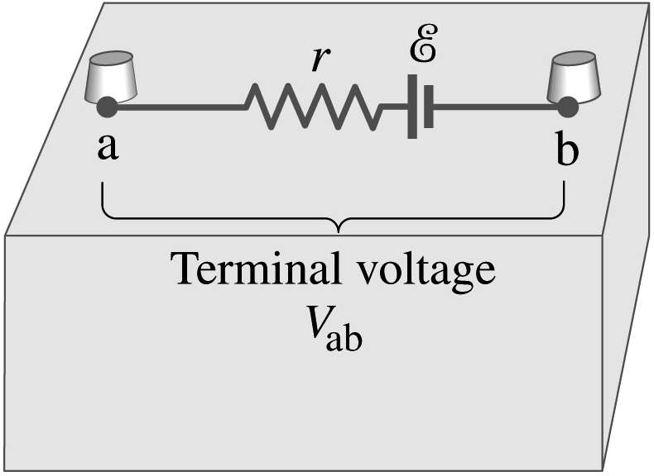
The “charge pump” does work on charges by non-electrostatic force to maintain the potential difference between two terminals (电源以非静电力对电荷做功,用以维持两极间的电势差).
So, the emf of the emf device can be defined in terms of work as:
The emf ε points to positive terminal within internal circuits (scalar).

Slide 7
The unit of ε is J/C (V).
If 非静电性电场强度 is introduced:
Then,

